Slide 1
Artificial Intelligence and Chatbots
The Basics – by Naman Sinha

Slide 2
“Artificial Intelligence, deep learning, machine learning — whatever you’re doing if you don’t understand it — learn it. Because otherwise you’re going to be a dinosaur within 3 years.”
— Mark Cuban

Slide 3



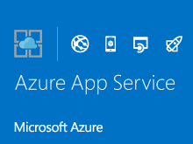



Agenda
NodeJS
Restify
MongoDB
VSCode
Azure App services
Git
Microsoft Bot Framework – Overview

Slide 4
Node.js Basics

Slide 5
What is Node.js
Event-driven non-blocking I/O server-side JavaScript environment based on V8.
Facilitated by Linux Foundation Collaborative Projects.
For easily building fast, scalable network applications.
Also used for building applications which are
Data intensive
Real – time
Run across distributed devices.
Developed by Ryan Dahl
Is it a JavaScript framework?
Originally written in C, C++
Implements JavaScript

Slide 6
Installation
Install Node.js.
Create a new project folder.
Through command – line, ‘cd’ to the project directory.
Run ‘npm init’ (This will create package.json).
Create a new file ‘app.js’ at the root and enter following line of code.
With command – line still opened at root location run ‘node app.js’
You see the output on command – line. Congratulations!

Slide 7
Why Use Node.js?
C#
CLR
MSIL
JIT
Native Code
Java
javac
Bytecode
JIT
Native Code
It’s fast
Look at execution flow of some of the famous server side technologies.
One may defer on PHP here if Zend engine is used, where PHP will also be interpreted directly to Native Code by this engine. Two things:
Zend engine also requires your PHP code to be converted into Zend opcode first.
Node.js uses a non-blocking I/O model where most of the functions in PHP blocks until completion (sequential flow).
V8 JavaScript runtime engine is one among the fastest out there originally built for Chrome browsers by Google.
V8 is built on C++ and takes care of all the memory intensive work. It implements ECMAScript as specified in ECMA-262
PHP
phc
Bytecode
JIT
Native Code
Node.js
V8
Native Code

Slide 8
Why use Node.js?
Scaling
Horizontal
Vertical
Scale in (3 nodes -> 1 node)
Scale out (1 node -> 3 nodes)
Scale up (add components)
Scale down (remove component)
Non-blocking I/O model
For building highly concurrent applications.
Uses Observer pattern and callbacks*.
Single threaded Event loop* just cut the overhead of context switching (found in most of the multithreading paradigms) and yet it’s model supports asynchronous operations by proper use of callbacks. It also avoids race conditions. Why single threaded? It’s Javascript.
Scalability
Computing cost is decreasing day-by-day and multiple nodes can be added\removed any time with minimal cost.
Node.js only supports horizontal scaling as it’s single threaded. Does it matter?
Vertical scaling is used for Virtualization.

Slide 9

Why use Node.js?
Rich package manager – npm
Unified API
It’s JavaScript after all.
Same stack at both client and server side.
Easy and fast learning curve for web developers.
Some excellent frameworks built on node ease out the process of development.
Express
Restify

Slide 10
Callbacks
Method A
Callback function
var methodA = function(){…}
Method B
Function that calls back any function thrown at it.
var methodB = function(callback){
…
//do something and then
callback();
}
Method Main
Main method
methodB(methodA);
//another way of writing this
methodB(function(){…});

Slide 11
Callback Demo – Wake me up when September ends

Slide 12
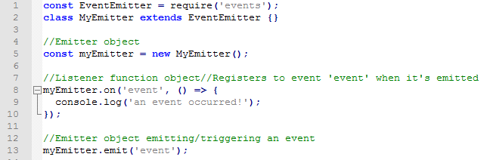
Event Emitters
Node.js core API is mostly built around idiomatic asynchronous event – driven architecture.
There will always be some emitters object here which will emit some named events and a listener function object which will register to these events.
All emitters objects are instances of EventEmitter class.
There must be a listener for error as and when they occur.
While .on() registers to event every time it’s emitted, .once() registers it just for the first time.

Slide 13
Event Emitters
Pretty much everything in Node emits events. E.g.: http.createServer, fs.ReadStream, Stream
Emitter A(e1,e2,e3)
Listener A(e3)
Listener A(e1)
Listener A(e2)
Emitter B(e1,e2)
Listener B(e1)
Listener B(e3)

Slide 14
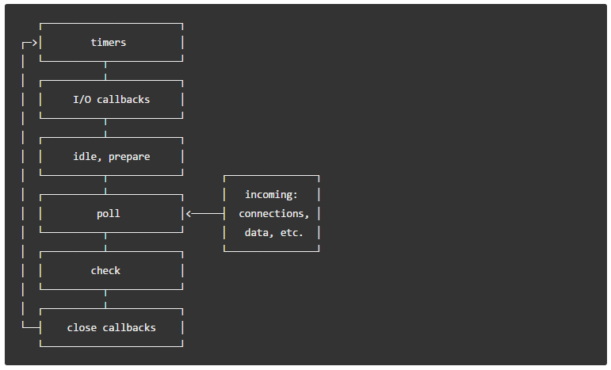
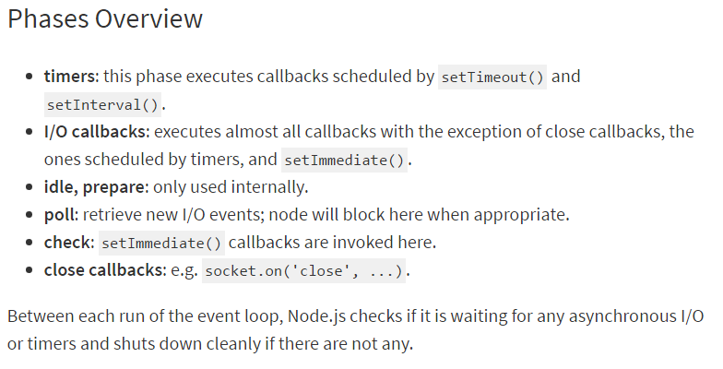
Event Loops
Node.js initializes Event loop as soon as it is started. E.g.: node app.js
Each phase has a FIFO queue of callbacks to execute.
This is what makes non-blocking model possible in Node

Slide 15
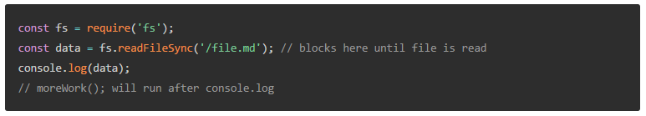
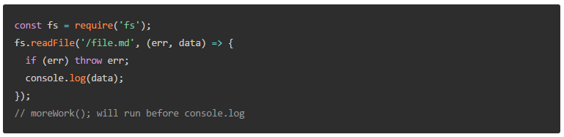
Blocking vs Non - Blocking
Blocking Code
Non – Blocking code
Sometimes mixing blocking and non – blocking code could be dangerous

Slide 16
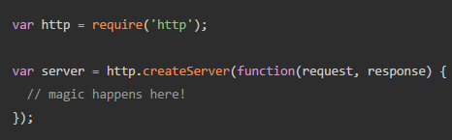
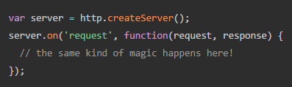
Anatomy of HTTP transactions
Take a note that we are creating a web server here.
http.createServer() creates a server which is nothing but an EventEmitter object (remember me!)
request and response are again ReadableStream and WritableStream.
Oh! Did I mention that streams are also EventEmitter object (and what do I do?)

Slide 17
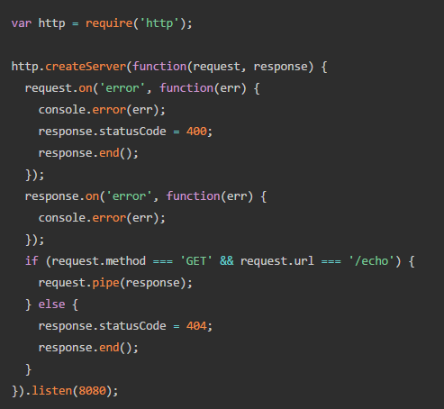
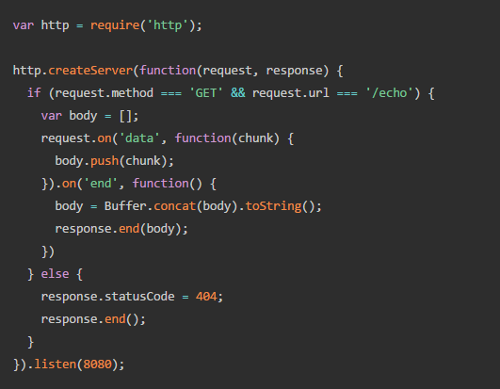
Anatomy of HTTP transaction
.pipe() is the real charm here. Buffer is just old story.

Slide 18
Restify Basics

Slide 19
What is Restify?
If you are familiar with Node Framework Express, then Restify = Express – Frontend goodies
Used for specifically building RESTful APIs (Server API) and Client APIs consuming the RESTful services.
Gain absolute control over HTTP interactions.
Gain full observability into
Latency
Characteristics of applications.
Comes with automatic DTrace support.
Installation

Slide 20
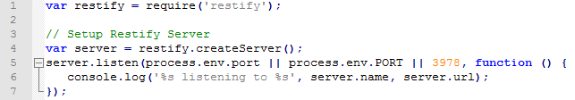

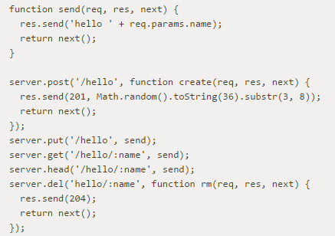

Restify Operations
Create a server.
Routing (Know more about Request API and Response API)
Create a Client
A simple GET operation
Know more about Client API

Slide 21
MongoDB Basics

Slide 22
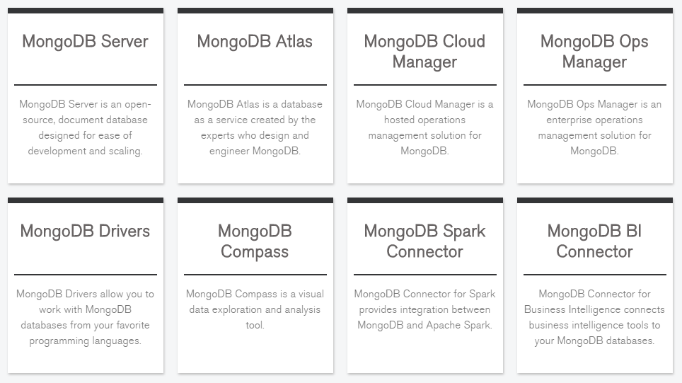

What is MongoDB
Installation of Node.js driver
Install MongoDB on your local from here.
MongoDB is an open-source, document database designed for ease of development and scaling.

Slide 23
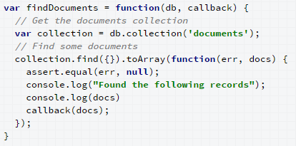
MongoDB concepts
Collections
Documents
Non – relational database.
MongoClient – Official MongoDB driver
A simple find operation

Slide 24
MongoClient and REST API Demo

Slide 25
Azure App Services and Git – Live demo

Slide 26
Microsoft Bot Framework - Overview

Slide 27
Microsoft Bot Framework - Introduction
Overview
Installation
Conversation
Messages
Attachments
Channel Data
Channel Store

Slide 28
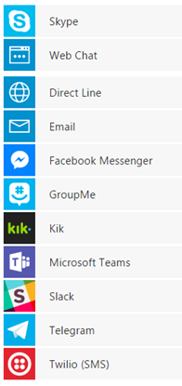
A sample Conversational Chatbot solution
Microsoft Cognitive Services
Registered and get App ID and APP secret. Store these in bot service.
Azure App Service
Microsoft App Store
CHANNELS
Web App
Bot Service
Register to bot framework with App ID and App secret
Endpoint URL - https://myhotel.azurewebsites.com/api/messages
Microsoft Bot Framework
Registered with Endpoint URL to bot framework
RESTful API
MongoDB

Slide 29
Q&A

Slide 30
How to contribute?
Ideate on Olympus with #ai or #chatbots.
Follow our Yammer Group for news and updates.
Reach out to naman.sinha@mindtree.com for questions/clarifications.

